Slide 1
HF Infrastructure Architecture Framework

Slide 2
Key Points
What is an Architecture Framework
HF Infrastructure Architecture Method (SAABR)
SAABR Architecture Phases
SAABR Architecture Phases Explained
Requirements Management
Physical Design Template
Benefits of an Architecture Framework
What Next?

Slide 3
What is an Architecture Framework?
Classic Definition: A set of tools, methods, patterns, and practices to help build different architectures. Best understood what it does for us and how do we use it.
Notes:
Classic Definition: A set of tools, methods, and practices to help build different architectures
Best understood what it does for us and how do we use it?

Slide 4
It helps build prescriptive architectures
It delivers a prescriptive architecture and associated artifacts
Notes:
Compare with descriptive architecture

Slide 5
Provides management of requirements
Business, functional and non-functional requirements are gathered and sanitized and delivered in the form of a final state architecture

Slide 6
Provides plumbing of building blocks
An architecture includes various building blocks like, servers, applications, networks, security components, non-functional requirements like availability, scalability, recoverability, and patterns etc.

Slide 7
All of that is done with a lifecycle approach
An Architecture Framework guides how these building blocks are build, retained and evolve

Slide 8
Architecture Development Method
An Architecture Development Method is the main component of an Architecture Framework which provides mechanisms to build an architecture

Slide 9
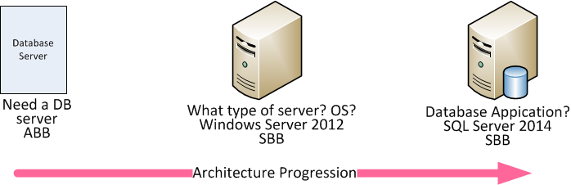
Architecture Building Blocks
Two Types:
Architecture Building Blocks - ABB
Solution Building Blocks - SBB
Notes:
Type of server? x86, RISC/ISA?

Slide 10

An organization needs an organization specific Architecture Framework & Architecture Development Method to guide its architecture

Slide 11
SAABR - Healthfirst Infrastructure Architecture Development Method
Comprised of four phases
S – Statement
A – Architecture
AB – Agile Build
R – Rollout
Notes:
Phases are discussed from slides 15 onwards

Slide 12
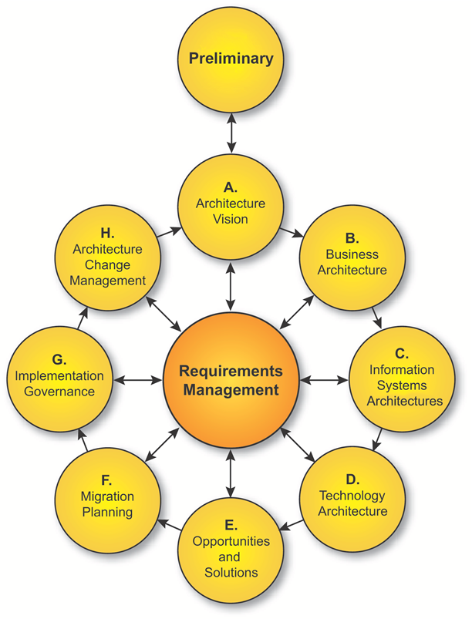
TOGAF ADM
HF Infrastructure Architecture Development Method is derived from TOGAF which is one of the major architecture frameworks. Architecture Development Method (ADM) is the main component of TOGAF which provides mechanisms to build an architecture
Notes:
9 phases

Slide 13
SAABR
Four phases are given the moniker SAABR (Read as Saber)
SAABR stands for:
S – Statement
A – Architecture
AB – Agile Build
R – Rollout

Slide 14
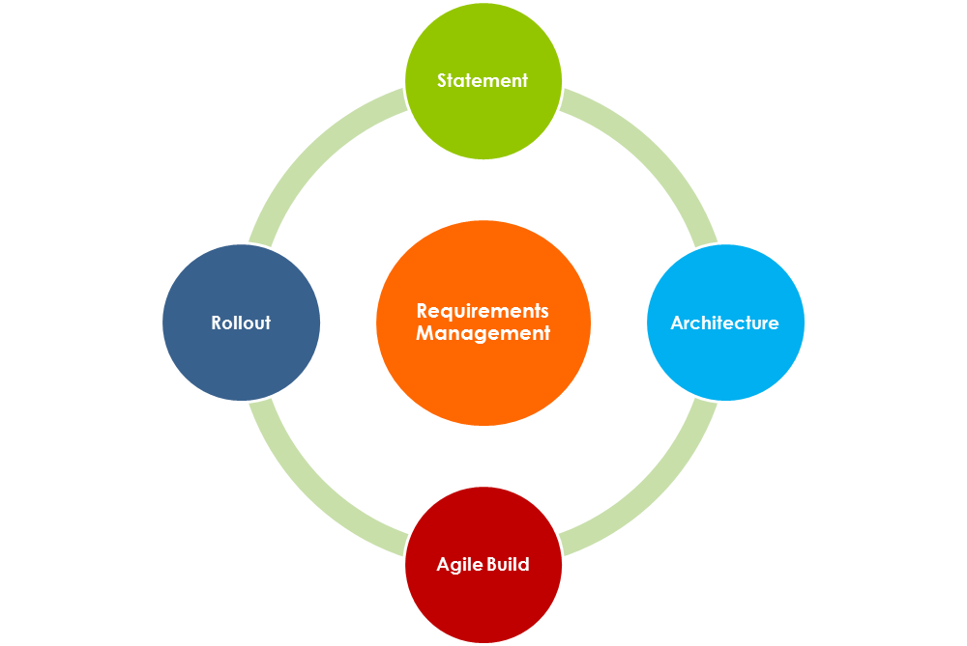
SAABR Architecture Cycle
Notes:
Requirements Management is not a phase. it is discussed in a separate slide

Slide 15
Premise of four phase approach
Know before design
Design before build
Build according to the design
Deploy business aligned infrastructure

Slide 16
SAABR Architecture Phases
Statement
High level project definition and requirements
Architecture
Gather requirements and build an Architecture design
Agile Build
Produce compute and storage layout and deliver physical or virtual capacity. Work on other requirements in parallel while provisioning
Roll out
Roll out the environment to end user
Notes:
S – Statement, A – Architecture, AB – Agile Build, R – Roll out

Slide 17
SAABR Architecture Phases
What SAABR is all about?
What are the objectives of each SAABR phase?
What are the key inputs and outputs produced during each phase?
Notes:
What we do during each phase and how each phase feeds to following phase

Slide 18
Objective of SAABR Phases
SAABR cycle produces an end state architecture using an iterative four phase process. Requirements are discovered and consumed during phases. SAABR is applied iteratively throughout the entire process, between phases, and within them.
Notes:
Core Objective: Discover requirements, sanitize, agree on requirements, consume requirements. Each phase is an iteration of a different Requirements Management phase
Requirements cycle:
Discovery
Sanitization
Agreement
Consumption

Slide 19
SAABR Phases
Next few slides explain each SAABR phase

Slide 20
Statement Phase
Project sponsor will open a Demand Request and provide a brief description of the project
Notes:
Need a repository system or a Request System which will track progress and changes, keep all the artifacts, and to upload and download required documents

Slide 21
Architecture Phase
This is the architecture development phase. This phase will consume inputs from the S-Statement phase and produce outputs for the Build phase.

Slide 22
Agile Build Phase
Ordered “Build Design Packages” are produced in parallel and delivered in the form of a Continuous Build Stream
Notes:
BDP or Build Design Package is a similar concept like ITIL SDP – Service Design Package. TOGAF has work packages which is to divide deployment work in smaller deployment activities

Slide 23
BDP1
BDP 2
BDP 3
Agile Build Phase will produce several Build Design Packages (BDP’s) in parallel

Slide 24
Continuous Build Stream Agile Build Phase
Continuous Build Stream
BDP 1
BDP 2
BDP 3
Notes:
Build Requirements will be gathered and packaged
Derived from TOGAF work packages and ITIL Service Design Packages

Slide 25
Rollout
Architecture is now available for end user use. This phase may include UAT and user simulation.

Slide 26
Requirements Management
Requirements Management applies to all phases of SAABR cycle. Requirements Management is a dynamic process identifying requirements throughout SAABR cycle and stores them in a repository system (SNOW? SharePoint?, Other?). These requirements evolve from ABB to SBB and are produced and consumed through out SAABR cycle.

Slide 27
Physical Design Template
It is a diagrammatical representation of the physical design of an infrastructure architecture depicting physical artifacts like servers, storage, networking components, and software components
A Visio design template will be presented

Slide 28
Benefits of an Infrastructure Framework
Efficiency
Visibility
Agility
Controllability
Notes:
Reference TOGAF v 9.0

Slide 29

Efficiency
Technology and processes are standardized
Stream lined buying because of information availability
Easier upgrade and exchange of system components
Repeatable artifacts
Notes:
How efficiency is achieved

Slide 30

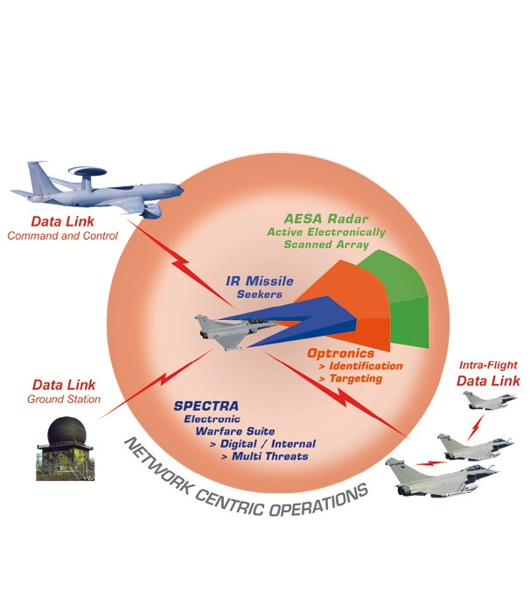
Visibility
Situational awareness, able to see blind spots, large radar crossection
Notes:
What is Visibility
Benefits of Visibility

Slide 31
Visibility
IT Leadership know what’s going on!
Stake holders; IT Leadership and business owners have a better visibility of technology landscape → Helps in decision making

Slide 32
Visibility
Business and capabilities shared across organization because of Infrastructure knowledge
Lower software development, support, and maintenance costs because knowledge of existing systems helps in reusability and to avoid building duplicate systems

Slide 33
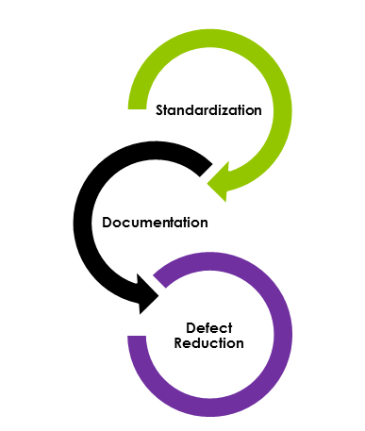
Agility
Standardization reduces defects
Availability of a catalogue of standard organization-wide product portfolio like physical bundles, virtual shirt sizes, and COTS eliminate guess work
IT is able to respond rapidly

Slide 34

Controllability
Architecture cycle provides several toll gates to check what is going into the datacenter helping IT leadership to control spending

Slide 35
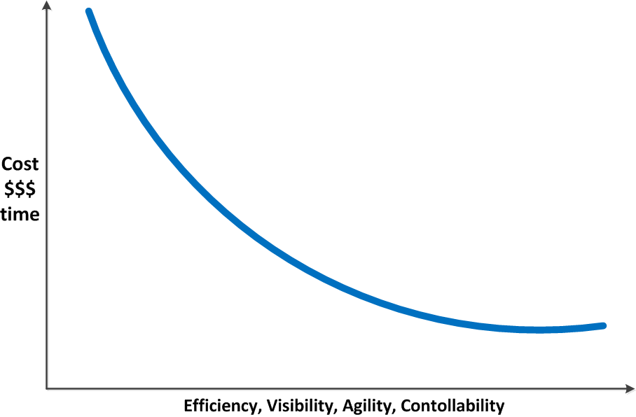
Benefits of an Infrastructure Framework
All of that help reduce cost and improve efficiencies across IT operations

Slide 36
What Next
Develop Infrastructure Architecture Principles
Virtualize where possible
Use of SAN storage (for physicals)
Tier-1 and Tier-2 applications should have a DR environment (Discuss)
Notes:
Virtualize where possible, otherwise ask for business justification. Get current, historical or expected performance data to validate compute requirements.
Need to properly size virtual or physical compute capacity.

Slide 37
What Next
Incorporate an exception process in certain situations
Incorporate a governance process to stop an architecture project if it does not meet business goals

